Slide 1
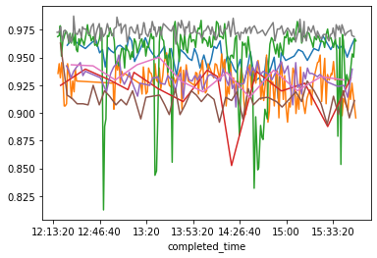
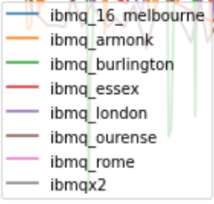
Analysis of Simple Errors
Wrote functions to execute any circuit repeatedly across all IBM machines for future use (maximizing allowed bandwidth).
Queued jobs are also tracked approx once/min to see queue progression.
Used here to find errors for a simple ‘NOT-then-measure’ circuit
% mmts correct

Slide 2
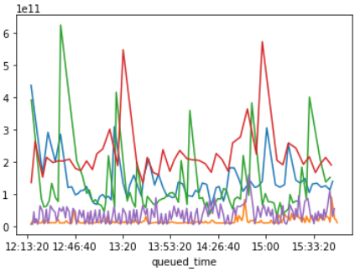
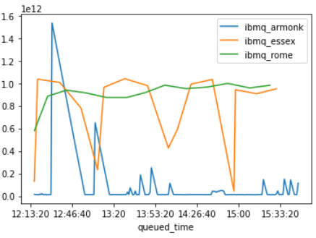
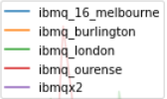
Analysis of Execution Times & Queueing
Also used above circuit to find variance in execution times on the backends.
IBM hide their queue priority algorithm but mention it takes into account how many jobs you have submitted in a floating time window. Here we plot total execution time (start queueing → finish) vs time queue joined.
100s of seconds
1000s of seconds

Slide 3
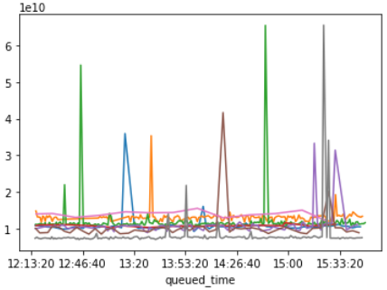
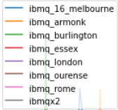
Analysis of Execution Times & Queueing II
I did the same for runtime on the machine (ie not including time spent queueing). This shows sometimes machines take a huge amount of time to compute this simple circuit (thankfully infrequently). This matches what people are experiencing in the community.
10s of seconds

Slide 4
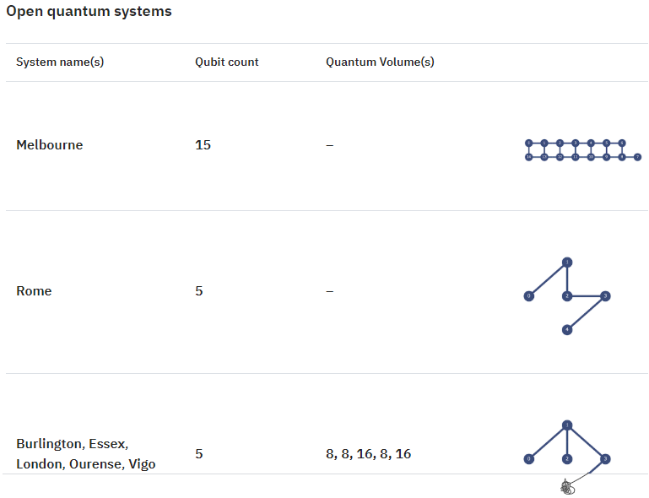
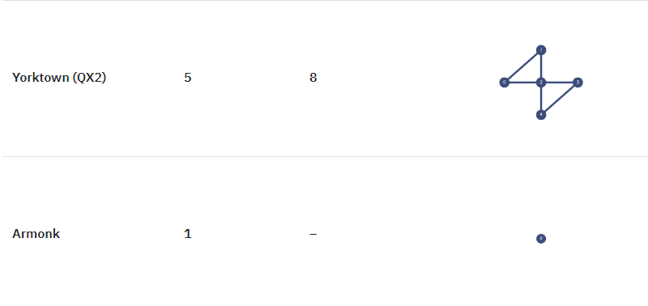
IBM’s Open Access Backends (for reference)

Slide 5
Execution Times & Queueing – Other Observations
IBM tend to limit the maximum number of jobs that can be submitted to queue to 1-3 depending on backend.
(Somewhat unethical) but it may be possible to run data-getting code on separate AWS instances under different accounts to maximise data
Backend throws exceptions very infrequently (<1 % of jobs sent yielded unreliable data). IBM’s framework seems overall robust.

Slide 6
Other Documentation Explored
Pulse-level control: IBM seems to allow control of backends to the level of the pulses used to execute the circuit. This allows incorporation of wait times in the code to measure time for qubit decoherence. Tutorials are provided but haven’t yet gone through this.
Qiskit makes use of a ‘transpiler’ that optimizes circuits for backend runtime. Optimization can be manually switched off (I am working on building a demo).

Slide 7
Other Activities
Read Nielsen & Chuang C8. (Kraus operators, their probabilistic interpretation and applications to noise-finding) in a lot of detail.
Read intro paper to randomized benchmarking Characterizing Quantum Gates via Randomized Benchmarking Magesan, Gambetta et al.
Thoughts on further work: explore pulse-level control in further detail, explore job manager, explore running code on separate AWS servers to improve average queue priority and get data faster.

Slide 8
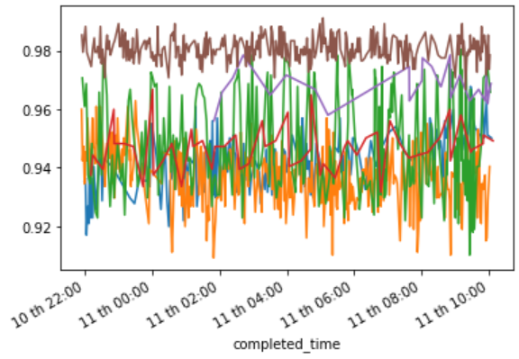
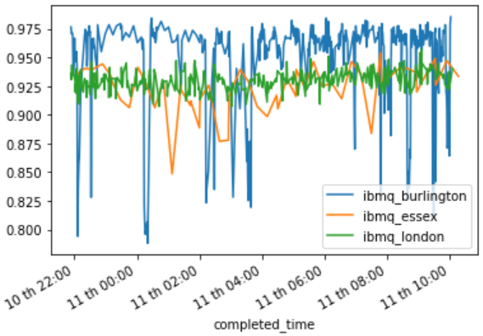
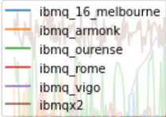
Accuracy (O/N)

Slide 9
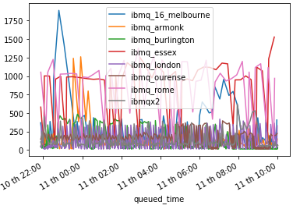
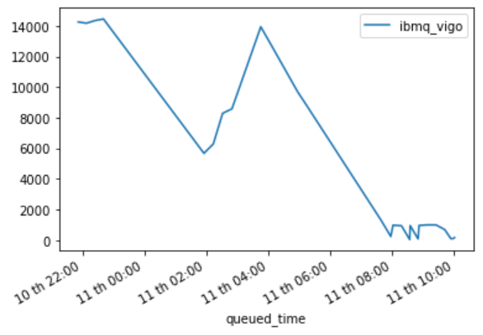
Total Execution Times (O/N)
Time taken to run in seconds, including queueing

Slide 10
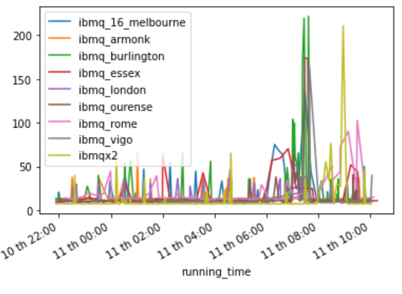
Runtimes Times (O/N)
Time spent running on hardware in seconds, not including queueing

Slide 11
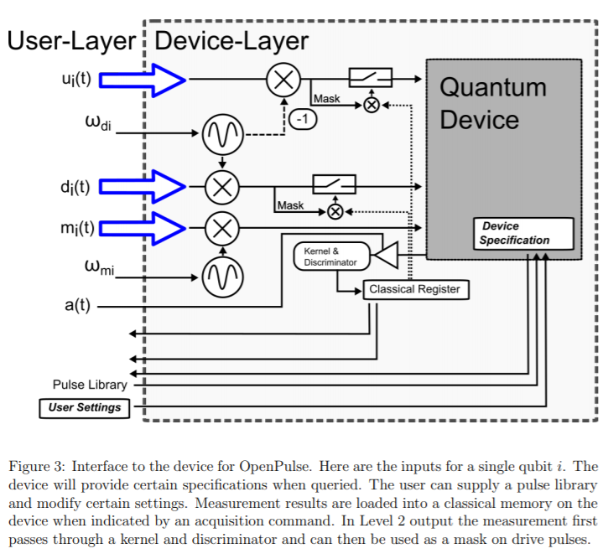
OpenPulse
Lower-level interface to quantum backends than OpenQASM.
Allows calibration of backend to current state, which minimizes calibration error.
I investigated whether calibrated sigma_x pulses have higher fidelity than OpenQASM sigma_x gates (which are based on default calibrations).

Slide 12
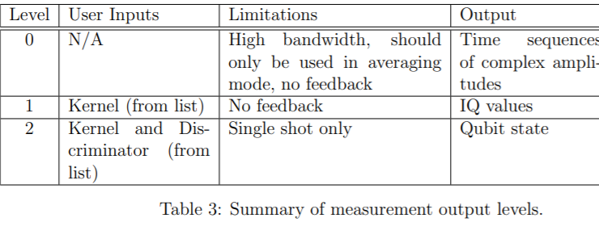
OpenPulse Outputs
(OpenPulse outputs require interpretation).

Slide 13
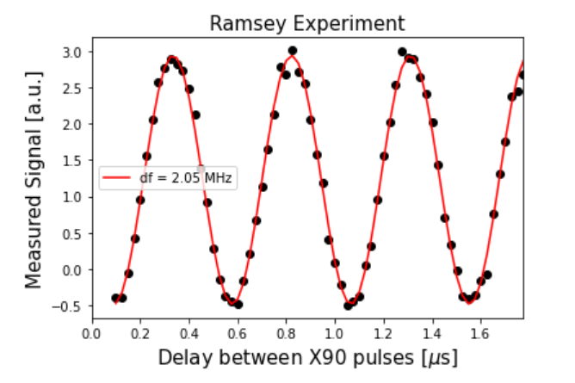
Ramsey Experiment for Qubit frequency using OpenPulse
IBMQ_armonk frequency found to be 4.974563 GHz (16 June 17:00), IBM-provided calibration data claims 4.97444579 GHz (16 June 13:07)

Slide 14
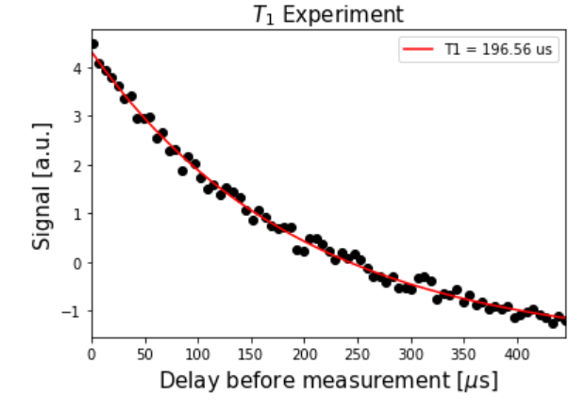
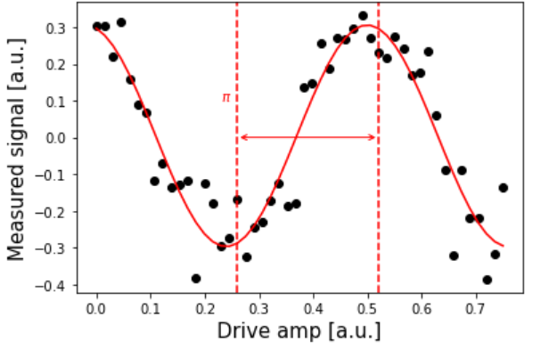
Characteristic amplitude damping time via OpenPulse
IBMQ_Armonk
Done with a fresh calibration
States prepared in |1> and allowed to decay.
Amplitude for X-gate for |1> preparation obtained via Rabi experiment
IBM-provided T1 was 194.5511 us (16 June 1307), our results at 16 June 5:30.

Slide 15
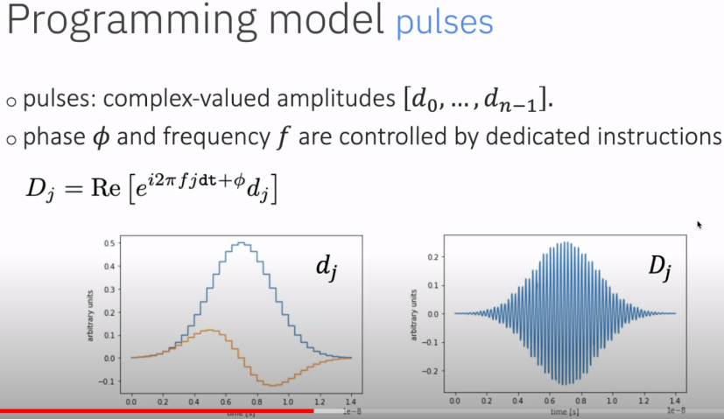
Control on OpenPulse (1 qubit)
Diagrams from ‘Quantum Coding with Lauren Capelluto’ on Qiskit Youtube https://www.youtube.com/watch?v=ZvipHRY-URs&t=126s
Single qubit control done by driving qubit with a Gaussian wavepacket of specified parameters.

Slide 16
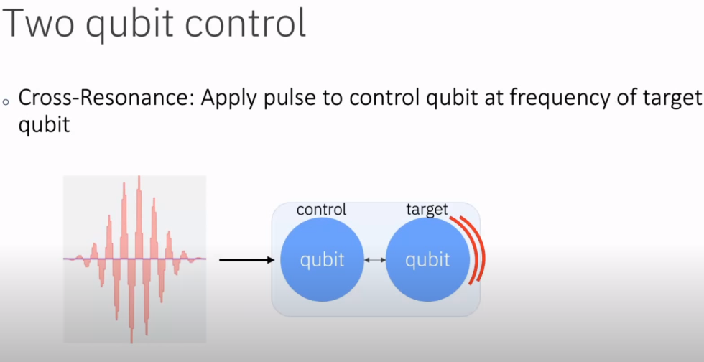
Control on OpenPulse (2 qubits)

Slide 17
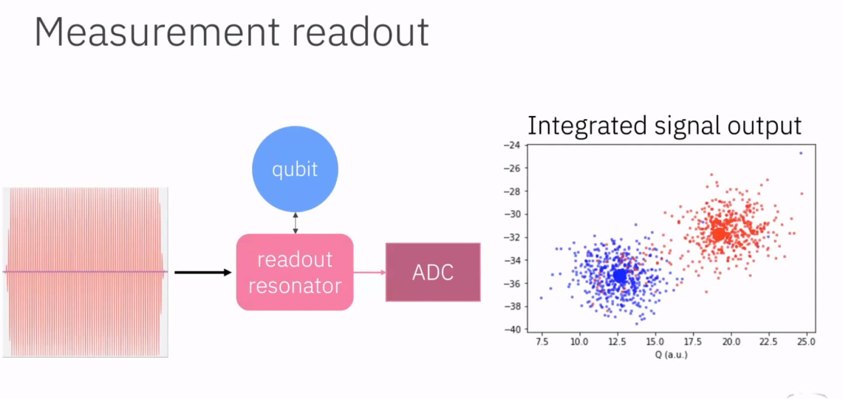
Metrology on OpenPulse
Qubit being measured is coupled to a readout resonator, pulse length is fixed in defaults. Signal reflects at a frequency dependent on the qubit state, and goes to ADC (analogue digital convertor).
Each point in this IQ plot corresponds to a single mmt. This can be used to construct a discriminator.

Slide 18
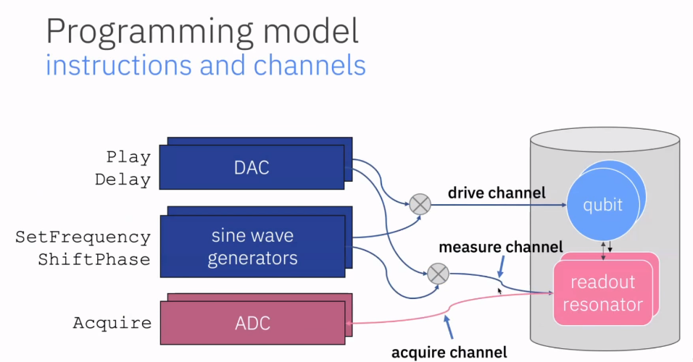
Metrology on OpenPulse - Stack
Full details in https://arxiv.org/abs/1809.03452

Slide 19
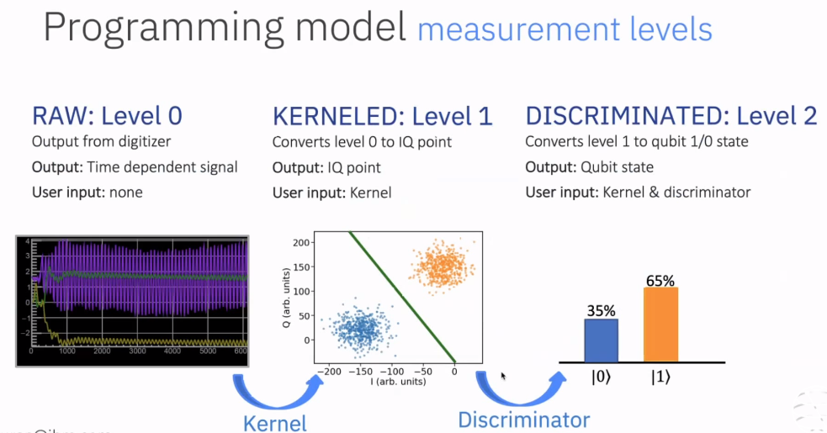
Metrology on OpenPulse – Measurement Levels
Full details in https://arxiv.org/abs/1809.03452

Slide 20
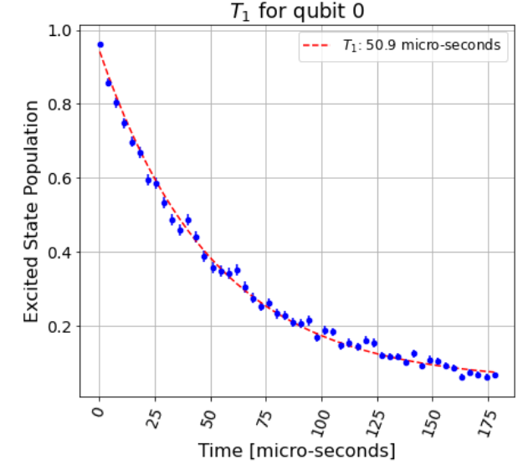
T1 experiment on OpenQASM (Qiskit-Ignis)
Ibmqx2 Qubit 0 T1 (real value = 73). Each point = 1000 shots.
Tried to use OpenQASM to produce T1 experiments for devices without OpenPulse.
Library Qiskit-Ignis is very well set up for all imaginable calibration experiments, also supports multiple parallel measurements when allowed on the backend. Works well on simulators suggesting no errors in code.
Encountered problems running on IBMQ backends.
Need identity gate time but data provided is suspect (does not match calibration data in some instances, which can be confirmed by my OpenPulse experiments).

Slide 21
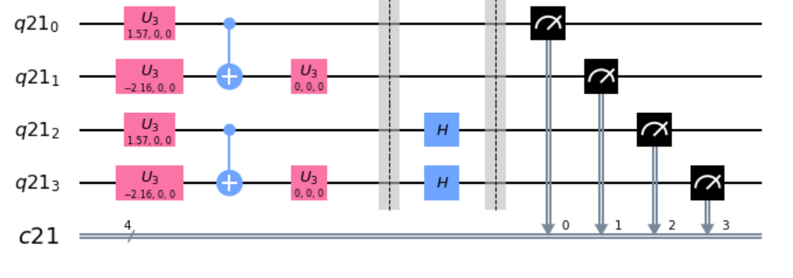
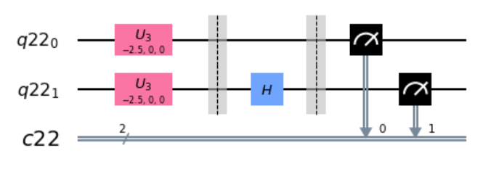
DFT Paper – method
Created circuits to the right to produce the necessarily measurements; replicated Paper results reasonably well
JobResult object comes with support like time running etc, using barriers to ensure the rotated and non-rotated circuits work in parallel.
Plan to use formulae found in Qiskit docs for propagating gate errors (see Github /openpulse_tutorials/gate_errors along with expected decay over circuit duration (T1) to fit the errors?

Slide 22
Problems and Questions with DFT Paper error
Need to know how exactly the circuit in paper was executed (how did tket optimize the circuit)?
Need to know which qubits were used and whether measurements were taken in parallel or sequentially (crosstalk vs measurement tradeoff).

Slide 23
Gate, Qubit and Mmt Errors - Theory
Good news - Gate and qubit errors are stored and retrievable from IBM database (not in docs!).
Main qubit errors are T1 (transverse relaxation/ amplitude damping) and T2 (dephasing or longitudinal relaxation). Both are measured and stored by IBM.
Main gate errors are amplitude and angle errors . IBM only stores average gate infidelity
Code used to retrieve error is same as in Qiskit-Ignis (manually tested for some qubits, sample results coming up in the next slides).
Results seem to be reliable close to the time of a calibration (as expected) but can differ significantly some hours after a calibration.

Slide 24
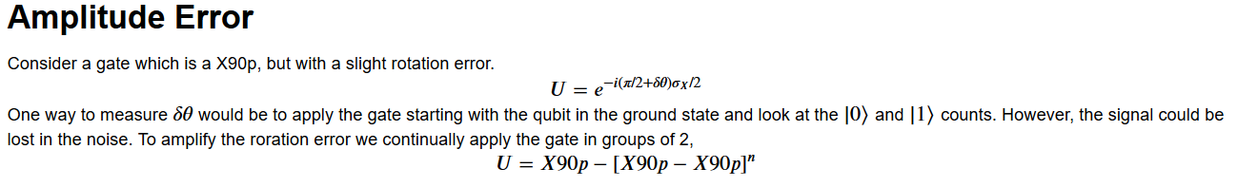
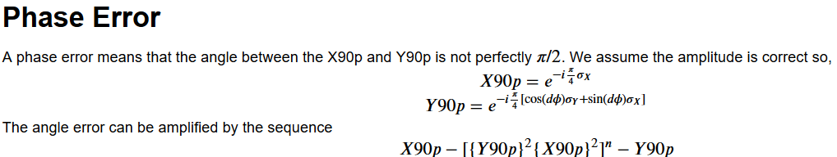
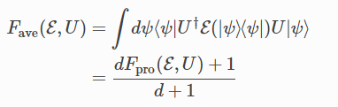
Gate Error Metrology
From ‘Gate Errors’, an open-source community notebook on Qiskit Github, by David McKay (IBM).
IBM store a more practical notion of gate error given by average gate infidelity , where fidelity is:

Slide 25
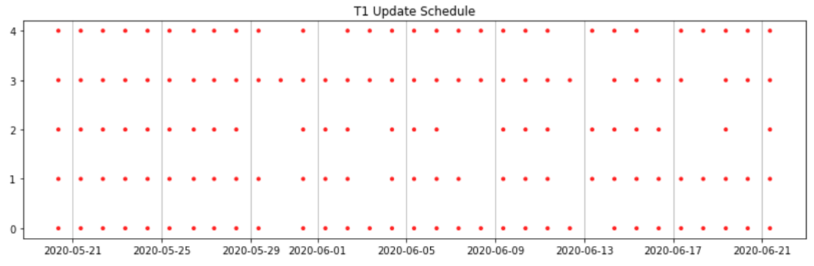
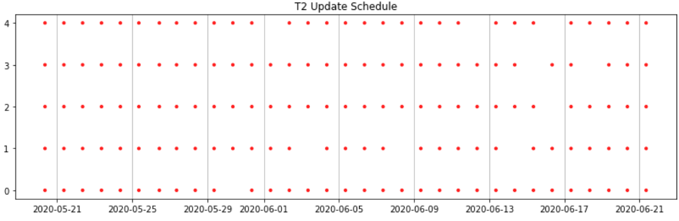
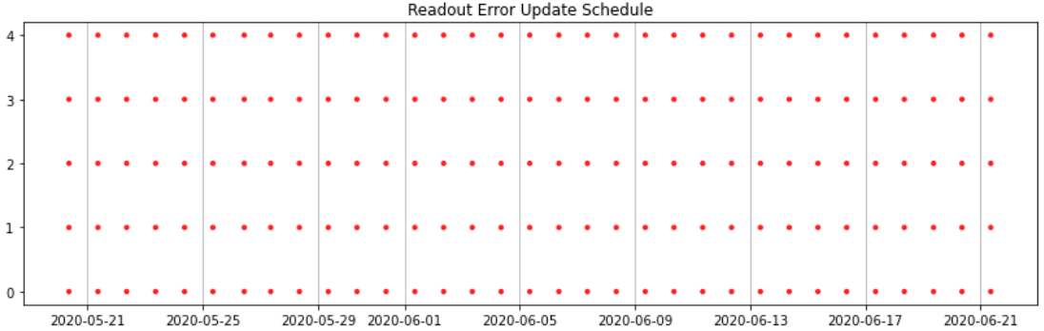
Calibration Schedules - Qubits
Trawled IBM database to determine when certain Qubit properties are updated over last month; results here are for ibmqx2 (vertical axis is qubit no.)

Slide 26
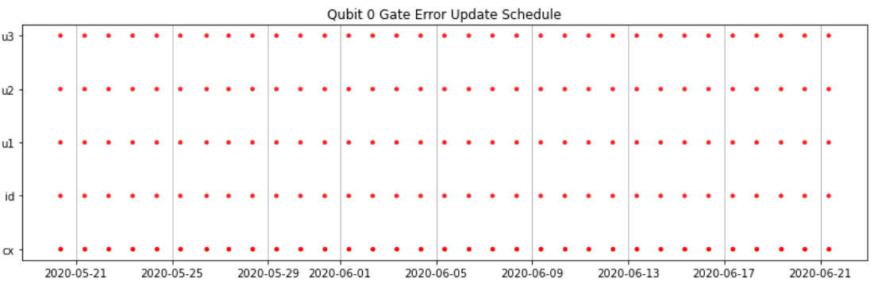
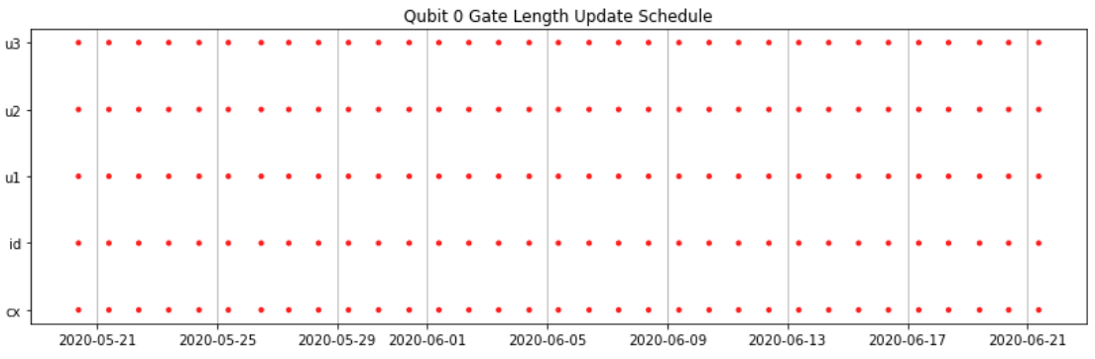
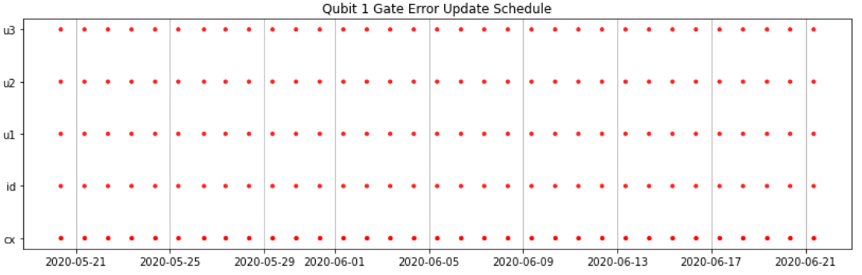
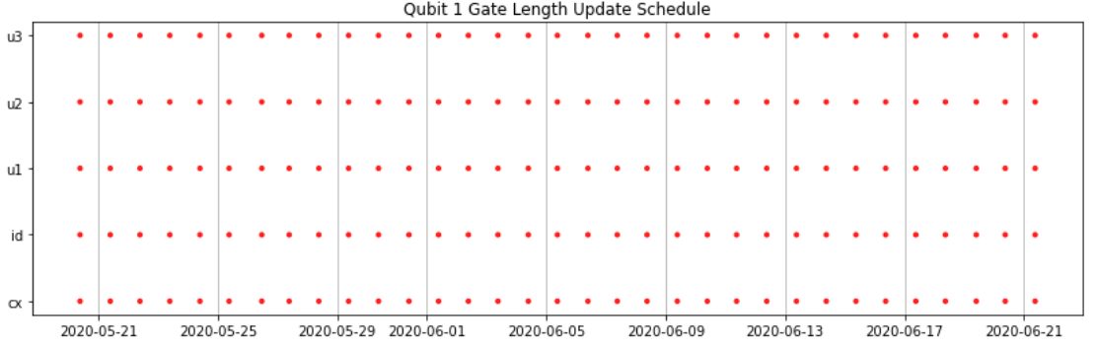
Calibration Schedules – Gates (I)
Same but for gates on each qubit. Subtle time differences between all readings (difference of up to O(10 minutes)).

Slide 27
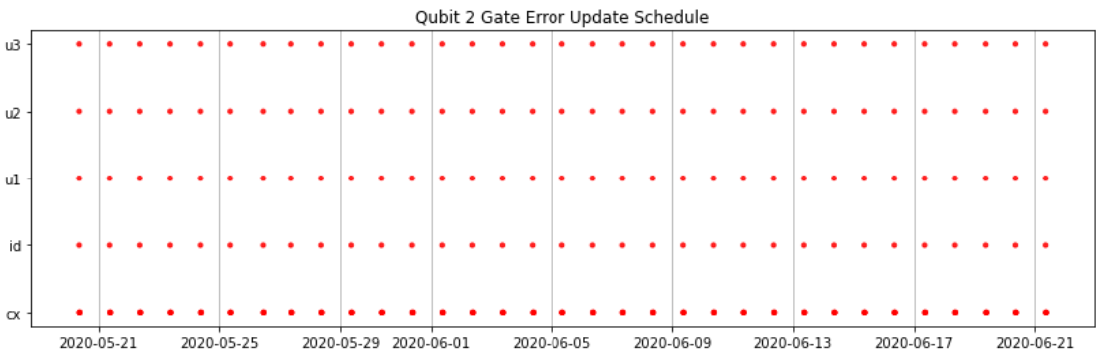
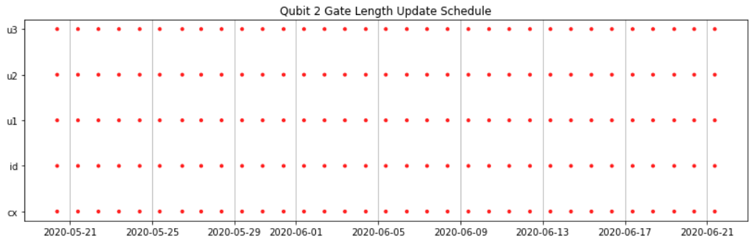
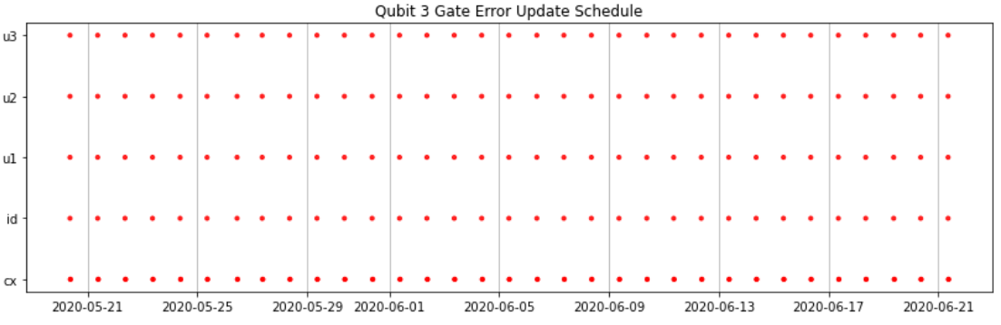
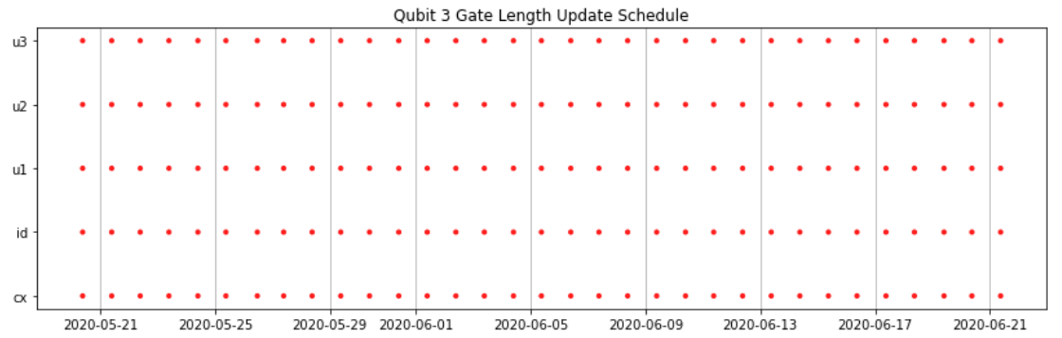
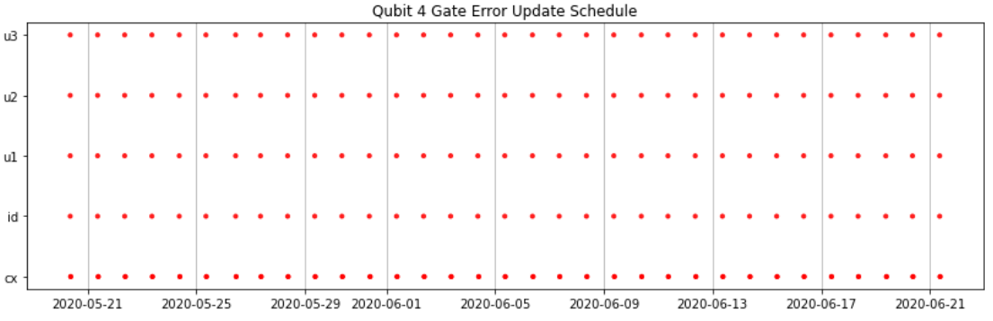
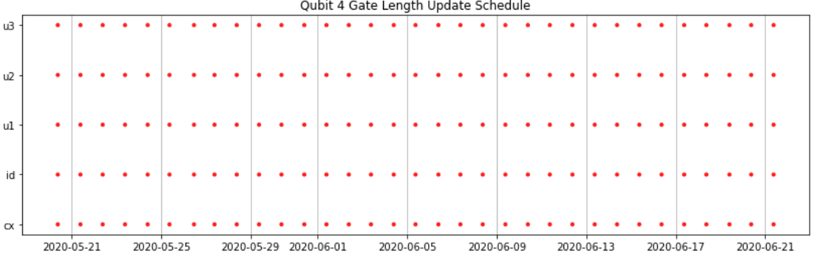

Slide 28
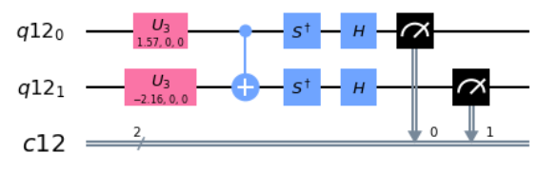
Applying to DFT Paper – State Tomography
Based on reliable nature of calibration schedule and overall error characteristics, decided to use gate 0 (along with 1 for 2 qubit circuit) for DFT paper. Stored results with detailed information about execution
For error modelling purposes also ran the circuits in such a way that they had the same number of gates and duration, so error is homoscedastic.
Obtained E0 = -0.917 (exact: -1.247) and E0 = -1.438 (exact: -1.795) for the two experiments.
Eg measuring a sigma_y here

Slide 29
Further ideas & Research
IBM lists ‘basis gates’ which all circuits are decomposed into at OpenQASM level, but at Pulse level all machines are using RX (using Pulse calibrations demonstrated earlier), RZ (or ‘U1’) which is implemented via software and CX to generate entanglement. From ‘Quantum Algorithm Implementations for Beginners’ (https://arxiv.org/pdf/1804.03719.pdf).
This paper on page 4 has an exact method to determine the Kraus operators (chi matrix) of a quantum gate (for 1 qubit): https://arxiv.org/pdf/1805.07185.pdf Phys Lett A

Slide 30
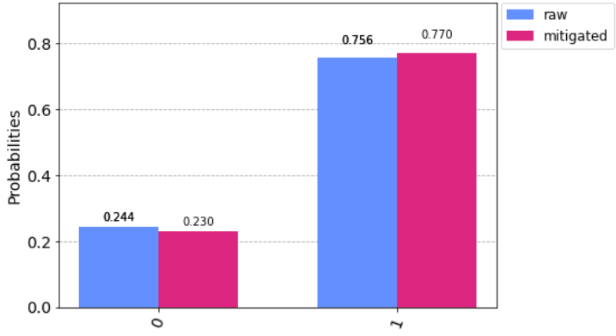
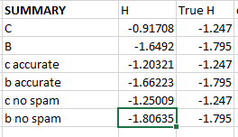
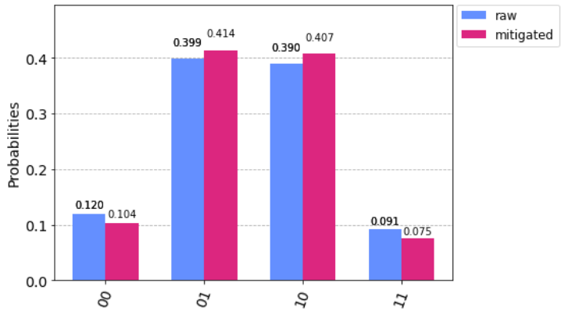
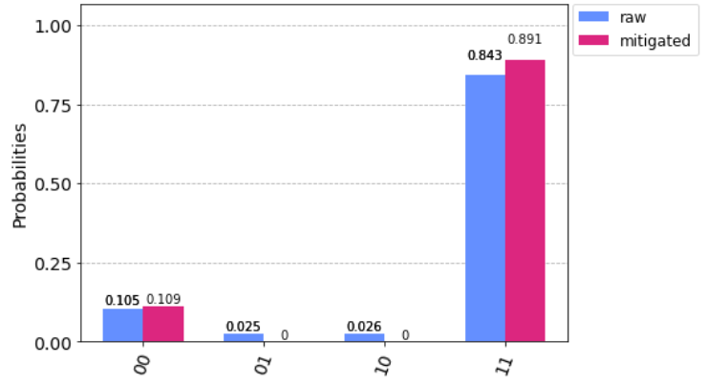
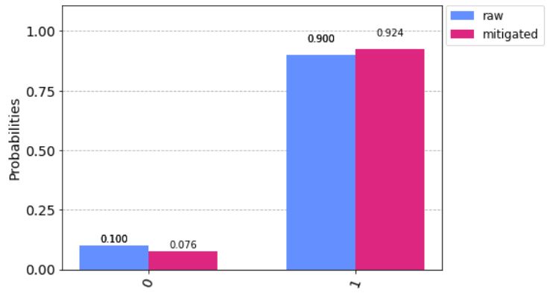
Accurate Results with SPAM Filtration
Boils down to using the classical probability measure & Bayes’ Theorem.

Slide 31
Applying to DFT Paper – Fitting Errors
To the right – Fig 2c (single qubit, single gate) DMFT paper experiment time vs number of shots. No easy way to determine exact experiment time. Hence used time implied by data.
Using the rough (IBM-provided) numbers, non-SPAM obtained results are within the allowed error range once time-related and time-independent errors have been accounted for.

Slide 32
Gate Characterization Techniques – an Overview
From https://arxiv.org/pdf/1509.02921.pdf tomography (like I have done for our specific gates) can calculate gate errors but is prone to SPAM which cannot easily be corrected.
RB is a good estimator (in most cases) of average gate infidelity, but only works for Clifford Gates (or averages of them).
Gate Set Tomography (https://arxiv.org/pdf/1310.4492.pdf) is a relatively new technique that will give exact gate errors without SPAM– but is this really necessary for our purposes? Will take a while to implement.

Slide 33



Amplitude Error Measurement X90 with |0> initial
No SPAM correction – previous paper implies this wouldn’t be a good idea anyway?
https://arxiv.org/pdf/1504.06597.pdf or details or slide 24 for derivation.
Obtained eps = 0.011434 rad for Qubit 1, 0.011303 rad for qubit 2.

Slide 34



Angle Error Measurement X90 with |0> initial
Measuring errors between Rx90 and Ry90.
Fit to function
obtained by similar working to amplitude error equation.
Obtained 0.010893 and 0.013031 error for qubits 0 and 1 resp.

Slide 35


Amplitude Error Measurement C0X1
Error measurement for the C0X1 gate using the same qubit setup as in DMFT paper circuit 2c.
Obtained rotation error 0.000983 which seems too low, fit pretty poor as well.
Method similar to earlier efforts using increasing number of CX gates; much longer gate time may be the problem?

Slide 36
General 1 Qubit Amplitude Error Measurement
Work in progress – method is similar to special case Rx90 already observed but crucially the fit function does not simplify as in (slide 24), so the fitting is less reliable.
I am looking into a better way to fit the curve using the X90 curve as an initial guess in this case – stay tuned!

Slide 37
Physical SPAM Filtration Scheme
https://arxiv.org/pdf/1910.07511.pdf demonstrates a way to separate SP and M errors for single qubit gates using quantum state tomography.
Spent a while thinking about how to mathematically devise a scheme to that restricts calibration to physical results (so our calibrated H > true ground H), but this is pretty difficult using a matrix approach as they do in IBM Qiskit – I think this would need Bayesian methods.

Slide 38
Noise Model for Overall Circuits in DMFT Paper
Caveat: all of the literature I could find only discussed time-independent (Markovian) errors, all gate error experiments etc are under the assumption that T1 and T2 >> gate times and so non-Markovian errors are negligible for small circuits (this is true for the IBM machines).
Initially it seems very hard to me to incorporate T1 T2 error etc in a rigorous noise model.
https://arxiv.org/abs/1610.05296v4 this paper provides mathematically rigorous bounds on circuit infidelities in terms of component infidelities, with more precise bounds for certain special cases.

Slide 39
CX Amplitude Error
Blue is special (done separately and soon after a calibration)

Slide 40

CX Amplitude Error –Blue Data Fit.

Slide 41



Repeating HongXiang’s Experiments for X180
(accidentally deleted the data for this one but wouldn’t make much difference)

Slide 42


Backend Implementation of a General U3 - Update
Things happen differently to what I thought! From Phys Rev A ‘Efficient Z Gates for Quantum Computing’ https://arxiv.org/pdf/1612.00858.pdf
Hence, Hongxiang’s rotation error vs angle experiment → we cannot

Slide 43



Circuit Fidelity Paper
https://arxiv.org/abs/1610.05296v4 discussed briefly last time.
Main result is a tight bound on circuit fidelity in terms of average component fidelities. This is tight for unitary channels (right)
A much better bound for Pauli error channels is below. The case between Pauli and Unitary error is also considered.

Slide 44


Single Qubit Error

Slide 45


Other Markovian Errors

Slide 46

Non Markovian Errrors

Slide 47



AmpCal Experiment with |1> starting
Error 0.015714 rads (no SPAM correction); 0.3077 (with SPAM correction).
Inconsistent with ‘normal’ AmpCal experiment: 0.009660 rads, 0.009432 rads SPAM corrected

Slide 48

Mathematics of Angle and Amplitude Errors
Summary of my own results (mathematically sound; need to design experiments to see if they happen on IBMQ).

Slide 49


Simulator Results (checking their Fitter works)
Amp error = angle error = 0.01
Unsurprisingly, correct result obtained – sampling close to Nyquist frequency

Slide 50



Amp error = angle error = 0.05 for many circuits
Penalization didn’t help; analytic function is a good fit

Slide 51


Slide 52


Amp error = angle error = 0.05 for fewer circuits

Slide 53


CX Experiment with control qubits measured.
CX with final control qubit state plotted.
Idea: penalize divergence from earlier points more

Slide 54

Maths

Slide 55



Calculating Amplitude Error
FT of the analytic fit function of n successive noisy X90’s shows delta function spikes at amplitude error (+ pi/4); no dependence on angle error.
Accordingly used FFT method; results worked reliably on the simulator with 300 X90 experiments and angle errors < 0.2 (right hand figure)
Spike at 0 is due to fit function ½ vertical shift in fit function.
Carrying out the same calculation on ibmq_Burlington gives angle error 0.0104719755 rad to 2 decimal places (left figure).

Slide 56
Investigating Angle Error dependence on Angle
‘Efficient Z gates for Quantum Computing’ shows that:
1) Angle error is dependent on pulse duration (Stark Effect & Fourier Broadening argument), but all drive pulses on a given IBMQ machine are the same
2) Angle Errors are small and easily corrected by a technique called DRAG shaping (although does not mention if this is implemented on IBMQ machines).
If there is no dependence on angle, then angle error is self-correcting (see OverLeaf) for all but the first gate in a sequence

Slide 57


Explaining HongXiang’s Error vs angle experiment

Slide 58


Repeated X Gate Expt Behaviour (II)
Blue dots fit to straight line with slopes 0.0135621, -0.00135059, r2 = 0.985.
(Angle Error measured was 0.014 rad using FFT technique, uncertainty in last digit)

Slide 59


Repeated X Gate Expt Behaviour - Analysis
Non-Markovian behaviour is really irrelevant here (as previously thought). Looking at the following formula for decay caused by T1 and T2 (N&C) and subbing in typical machine values, none of these experiments run long enough to cause a concern.
The Blue curves can just about be explained by theory & Taylor expansion.
The other one is a mystery perhaps explainable by variable angle error depending on the phases?

Slide 60
4 Qubit Experiment
Calculated an analytic formula for 4 qubit experiment theoretical output in terms of theta’s. Error models quite useless due to lack of understanding of how CX gate fundamentally works
Been reading ‘First Principles Analysis of XR Gate Operation’ to get an idea of CX gates in IBM superconducting machines so I can build a model similar to what I did for 1 qubit gates.
https://arxiv.org/pdf/1603.04821.pdf

Slide 61


Amplitude error can’t be ‘corrected’
The green lines are made with a ‘special’ pulse schedule that rotate by pi with no angle error, only amplitude error. Straight line fit is only due to a Taylor expansion.
The blue lines are a rotation, could be corrected but not a straight line.

Slide 62

Explaining these differences (part ii)
Narrowed down to being explained by dependence of angle error (dgamma) on phase offset (gamma).
The maths shows that the red (and green) curves made by U(0) (and U(pi)) pulses repeatedly are devoid of angle error.
Meanwhile for the blue curve, angle error is allowed to accrue

Slide 63

Work on 4 qubit model (Analytic)

Slide 64

Simulations
For some reason simulator doesn’t work for small amplitude error.
No way to set angle error to depend on phase.
Analytic error function on previous slide is trivial (but expensive) to calculate ASSUMING CX gates are perfect.

Slide 65
Legalities
IBMQ User License Agreement, 7c. You may not reverse engineer or otherwise attempt to discover or decode any hardware component of IBM Quantum.

Slide 66



DMFT 4 qubit circuit simulations
Using averaged noise (coherent and non-coherent from IBM data from 15 Dec 2019).

Slide 67






Slide 68


Previous experiments now run on Armonk give different results

Slide 69
4 qubit DMFT Circuit Data
Full version of data is still running & taking a long time (no SPAM, adapted to Yorktown, average CX error, decoherent errors etc).
Statevector results done and presented

Slide 70
Paper Summary
Abstract – a physical model for 1 qubit gate errors & accompanying experiments.
Intro – explain why RB is inadequate from the perspective of calculate errors for particular circuits. Introduce pulse Hamiltonian and implementation including VZ-gates and briefly go over existing backend error correction.
Results (analytic) –.
Results (experiments) – show from above both Gaussian DRAG & uniform pulse shapes. Calculate perturbation expansions of a general U2 pulsewhy x90^n experiment and experiments calculate gate errors. Domega via openpulse (Ramsey experiment). Including FFT method.

